Slide 1

Progress Presentation
13-02-2025
Prepared by: Marie Joe Sawma To: Dr. Reed Maxwell

Slide 2
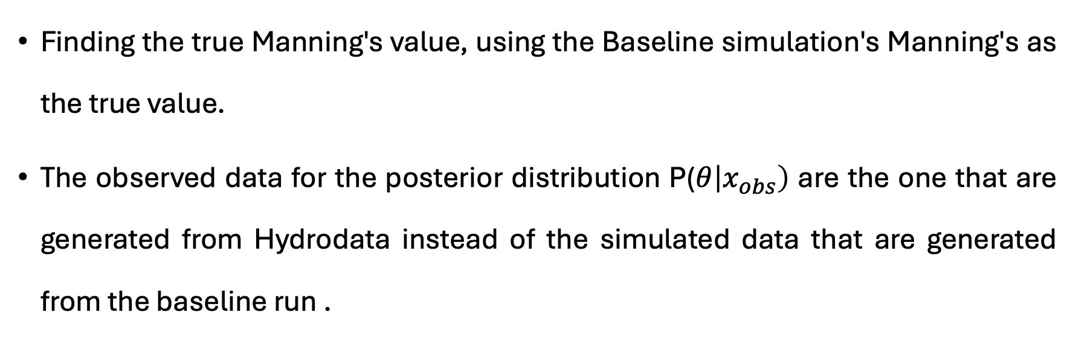
Objective
Finding the true Manning's value, using the Baseline simulation's Manning's as the true value.
The observed data for the posterior distribution P($θ\left|x_{obs}\right)$ are the one that are generated from Hydrodata instead of the simulated data that are generated from the baseline run .

Slide 3
https://parflow.readthedocs.io/en/latest/keys.html#mannings-roughness-values

Slide 4
Comparative analysis

Slide 5
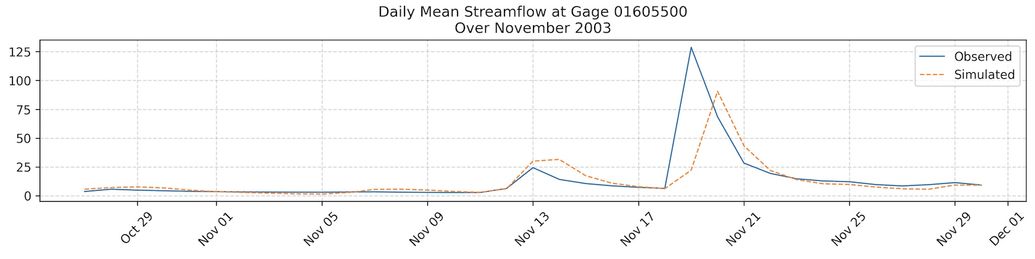
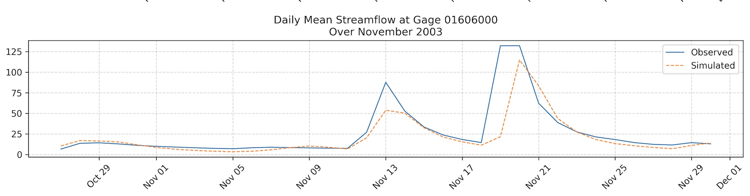
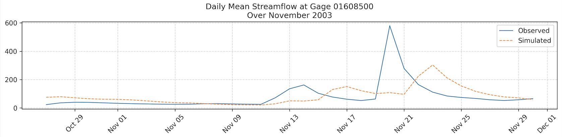

Slide 6
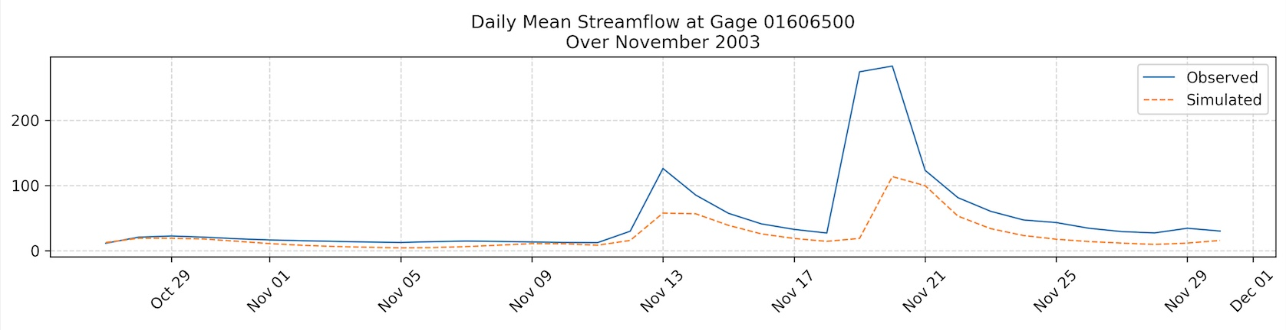
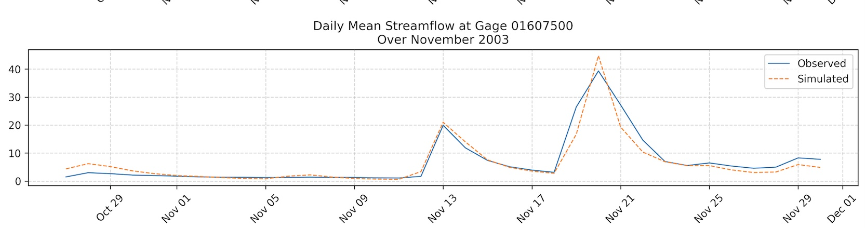
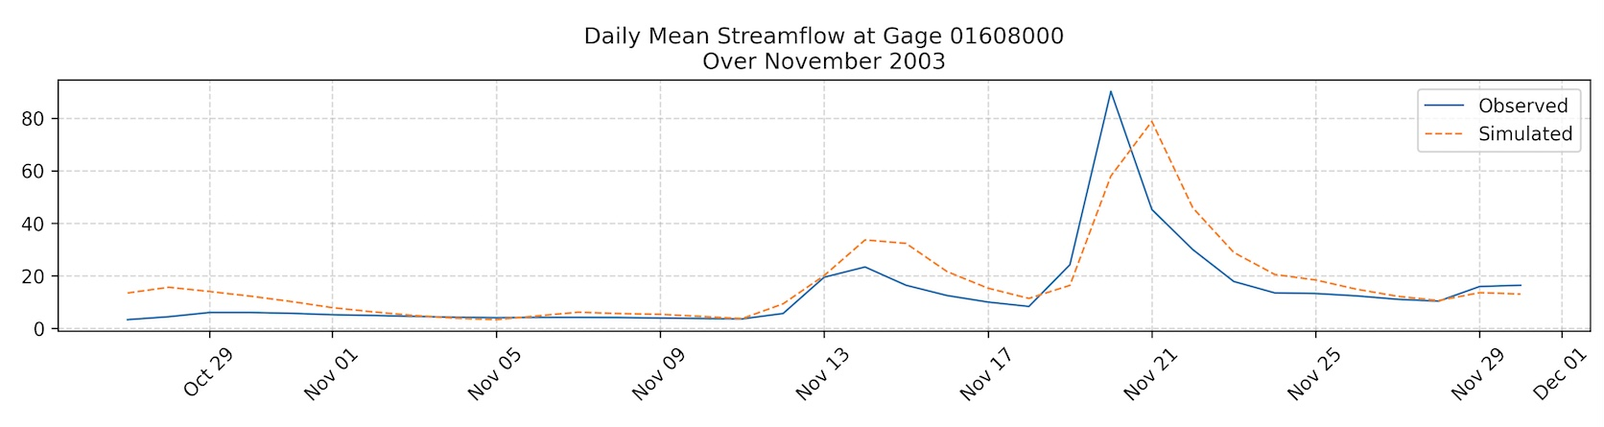

Slide 7
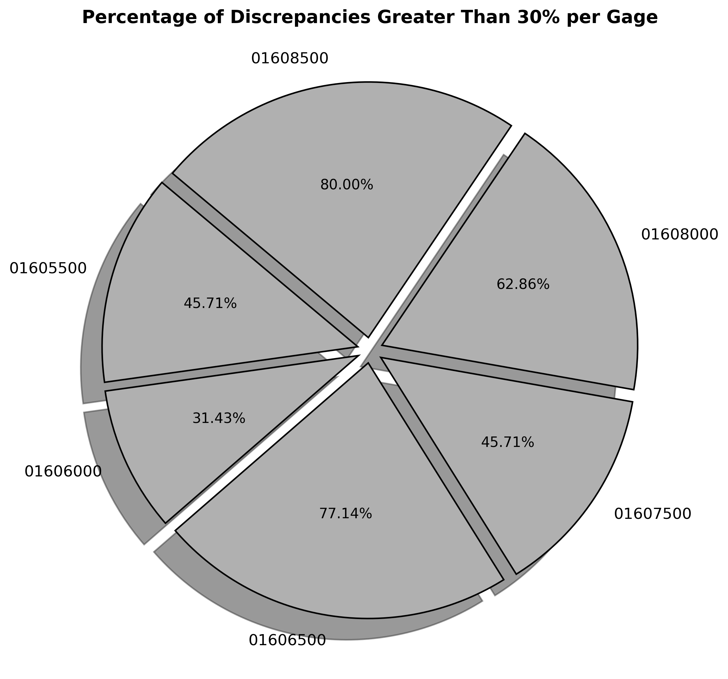

Slide 8
Gage: 01605500 | Observed data | Simulated data
Mean | 13.31 | 12.21
Standard deviation | 23.35 | 16.54
Gage: 01606000 | Observed data | Simulated data
Mean | 25.78 | 20.53
Standard deviation | 31.70 | 23.50
Gage: 01606500 | Observed data | Simulated data
Mean | 48.8 | 23.22
Standard deviation | 64.33 | 25.04

Slide 9
Gage: 01607500 | Observed data | Simulated data
Mean | 6.77 | 6.39
Standard deviation | 8.77 | 8.42
Gage:01608000 | Observed data | Simulated data
Mean | 13.38 | 17.05
Standard deviation | 16.16 | 16.17
Gage: 01608000 | Observed data | Simulated data
Mean | 80.14 | 84.66
Standard deviation | 101.62 | 62.70

Slide 10
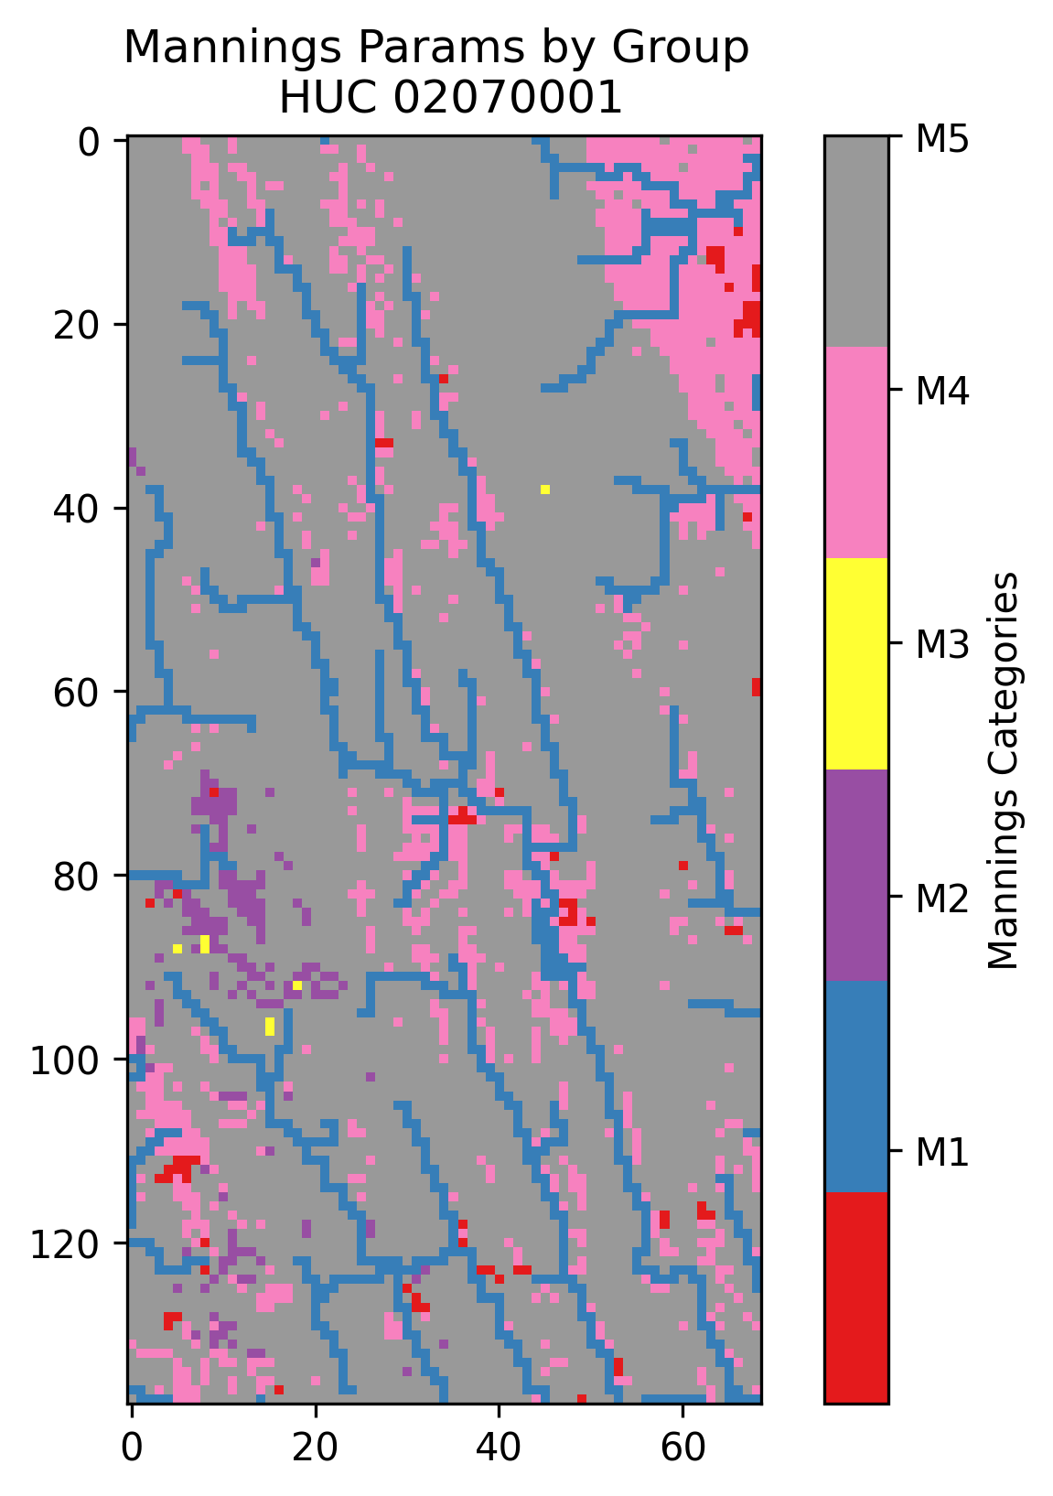
HUC : 02070001

Slide 11
Ensemble 1

Slide 12
Spread of data
After evaluating the variance between the simulated and observed data, we find that the observed data shows greater dispersion around the mean, leading to a higher number of outliers.
Therefore, increasing the number of simulations could help the model better capture outliers and improve data distribution.
we will initially run 100 simulations and, based on a visual inspection of the posterior distribution, we will assess whether this number is enough to train the model.
However, 100 simulations could not be enough as this number was necessary to train the model to be able to catch the true parameters given the simulated data of the baseline run

Slide 13
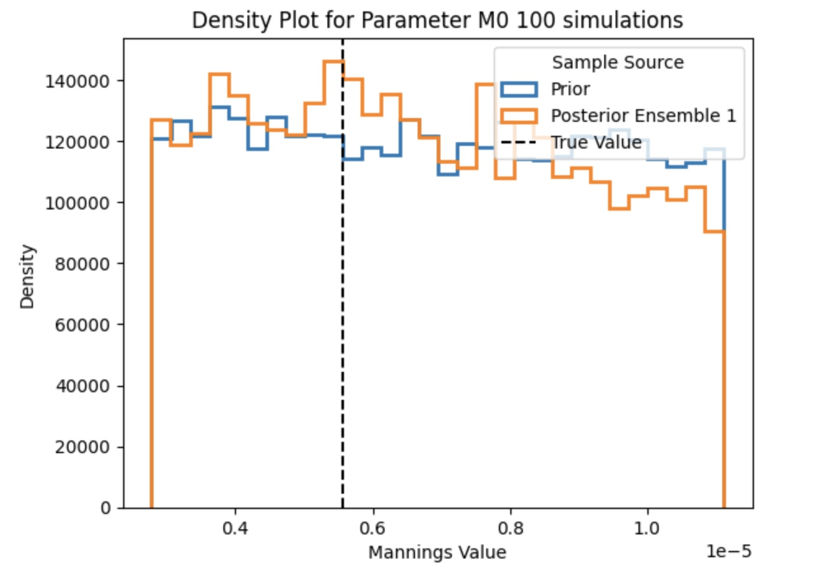
Density Plot for M₀
n = 100

Slide 14
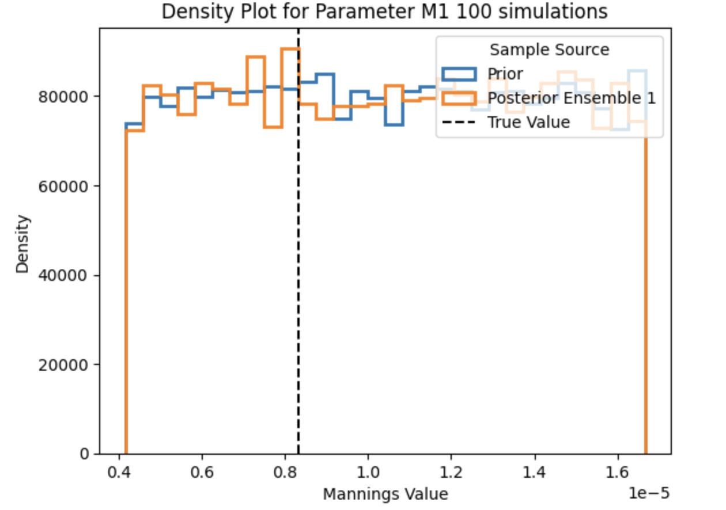
Density plot for M₁

Slide 15
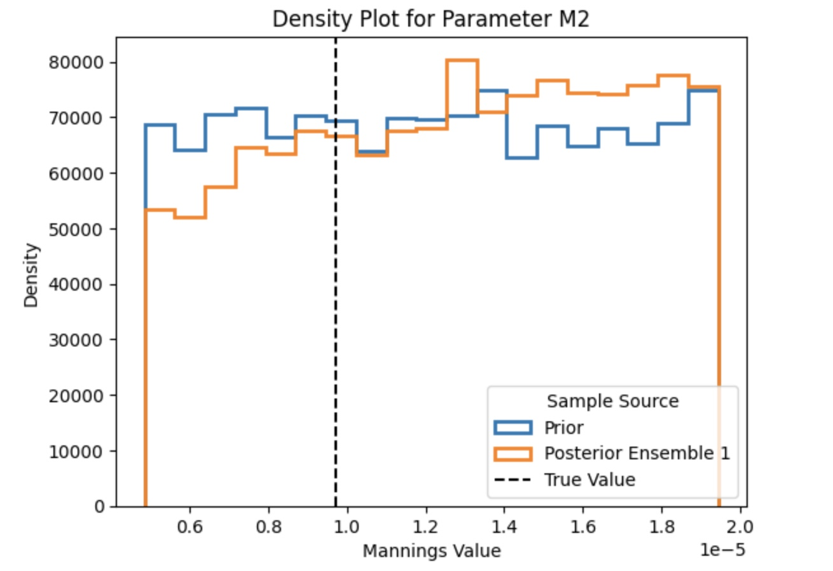
Density plot for M₂
n = 100 simulations

Slide 16
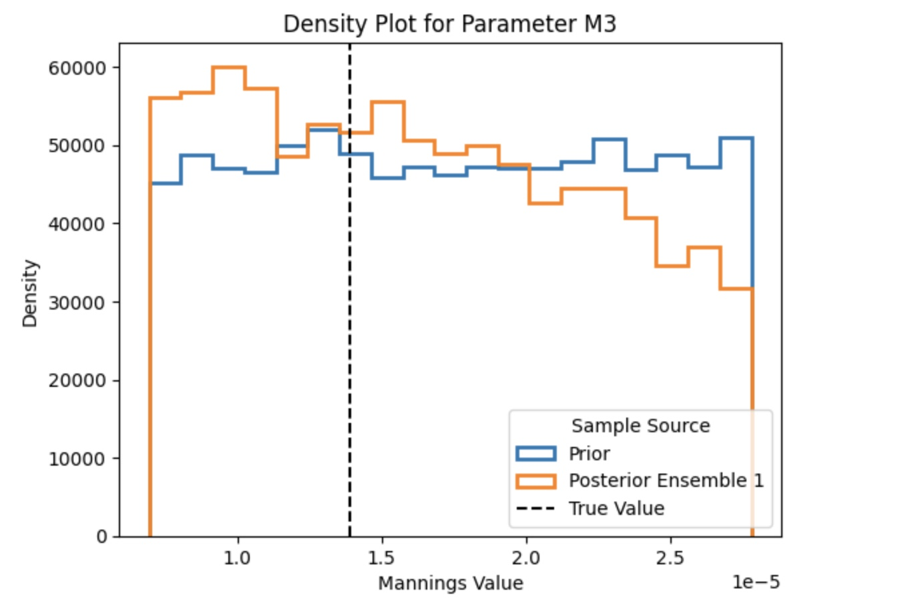
Density plot for M₃

Slide 17
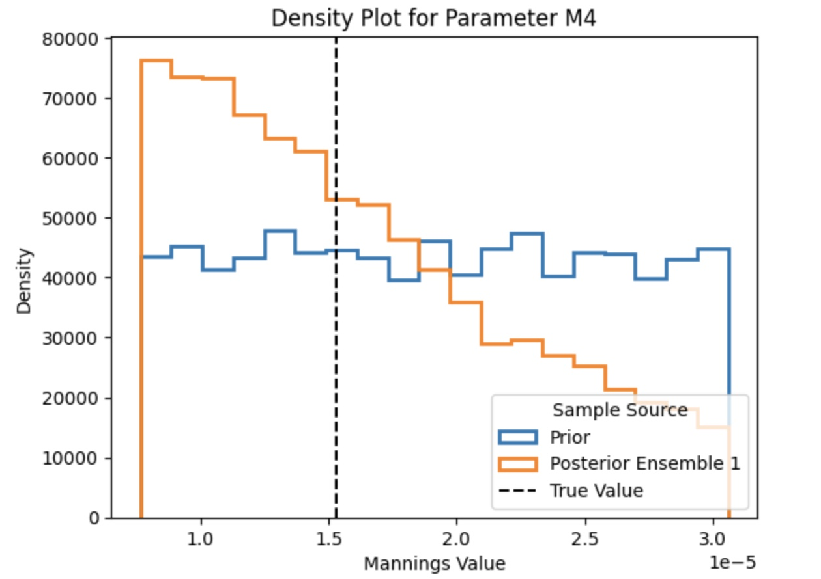
Density plot for M₄

Slide 18
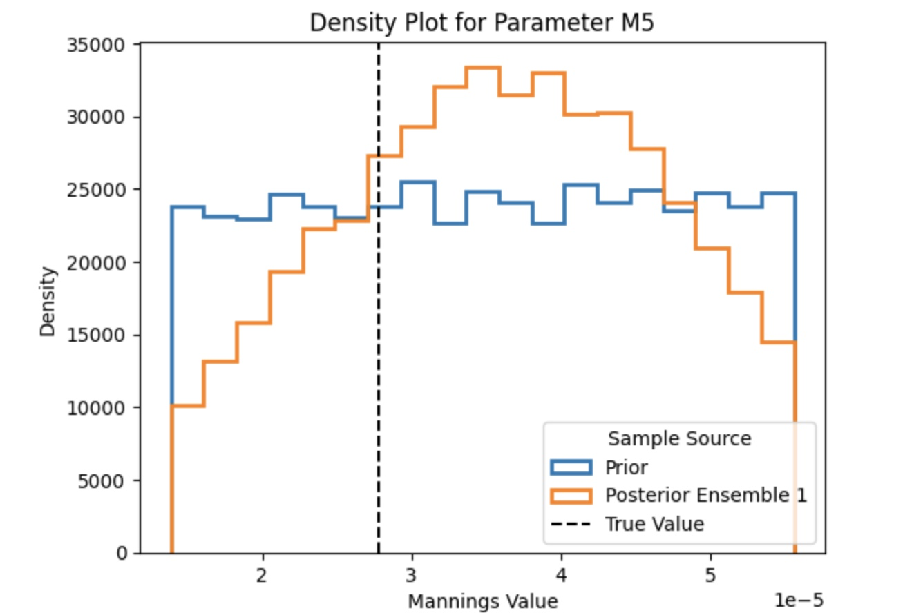
Density plot for M₅

Slide 19
Sampling problems
With 100 simulations and by considering the observed data as the true value, only 0.0981% of the samples are accepted

Slide 20
Spread of Data
After assessing the posterior distribution, we can conclude that the model has not been trained well on 100 simulations
I ran 400 simulations to train the model to learn and explore more the outliers

Slide 21
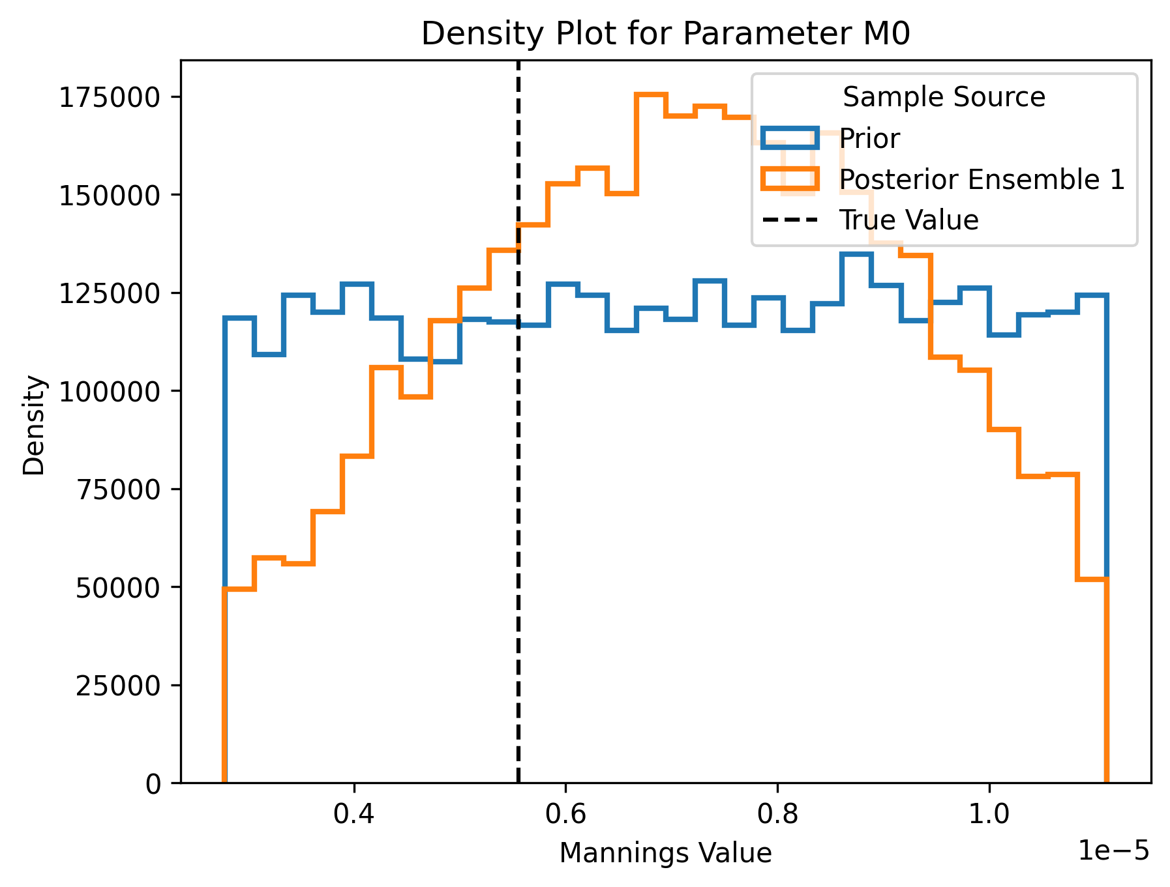
Density Plot for M₀
n = 400

Slide 22
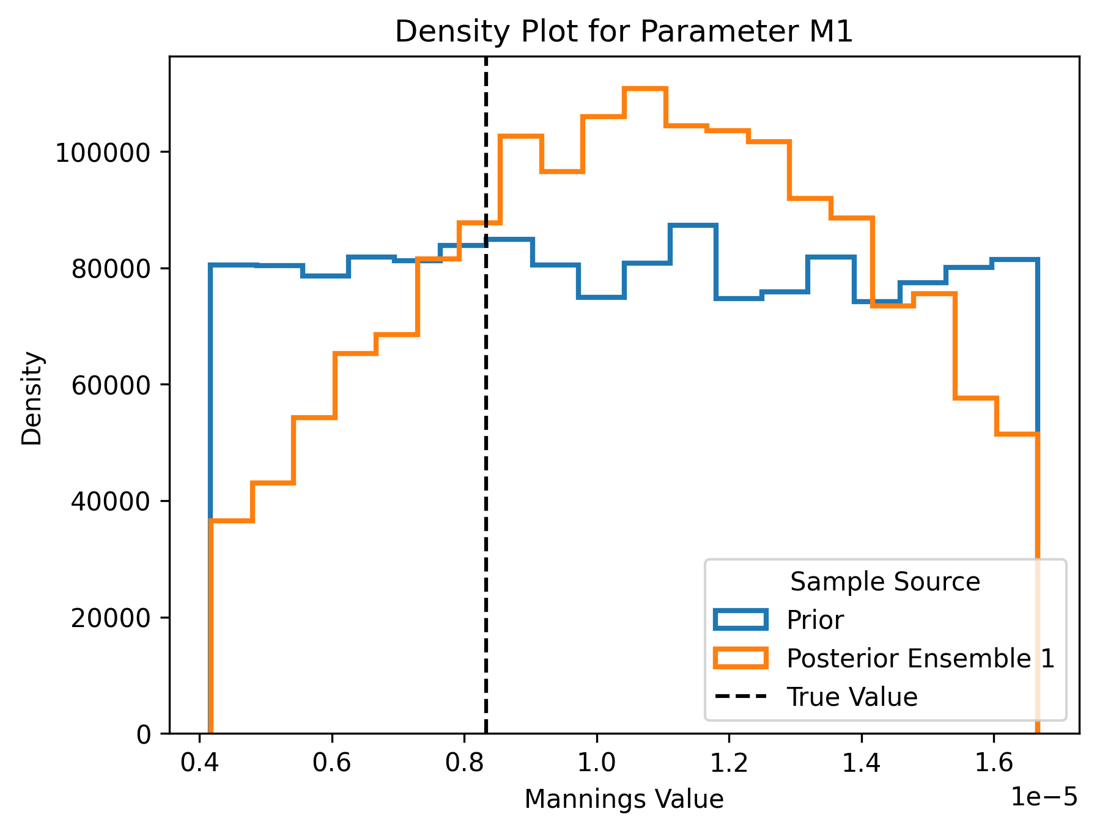
Density plot for M₁
n = 400

Slide 23
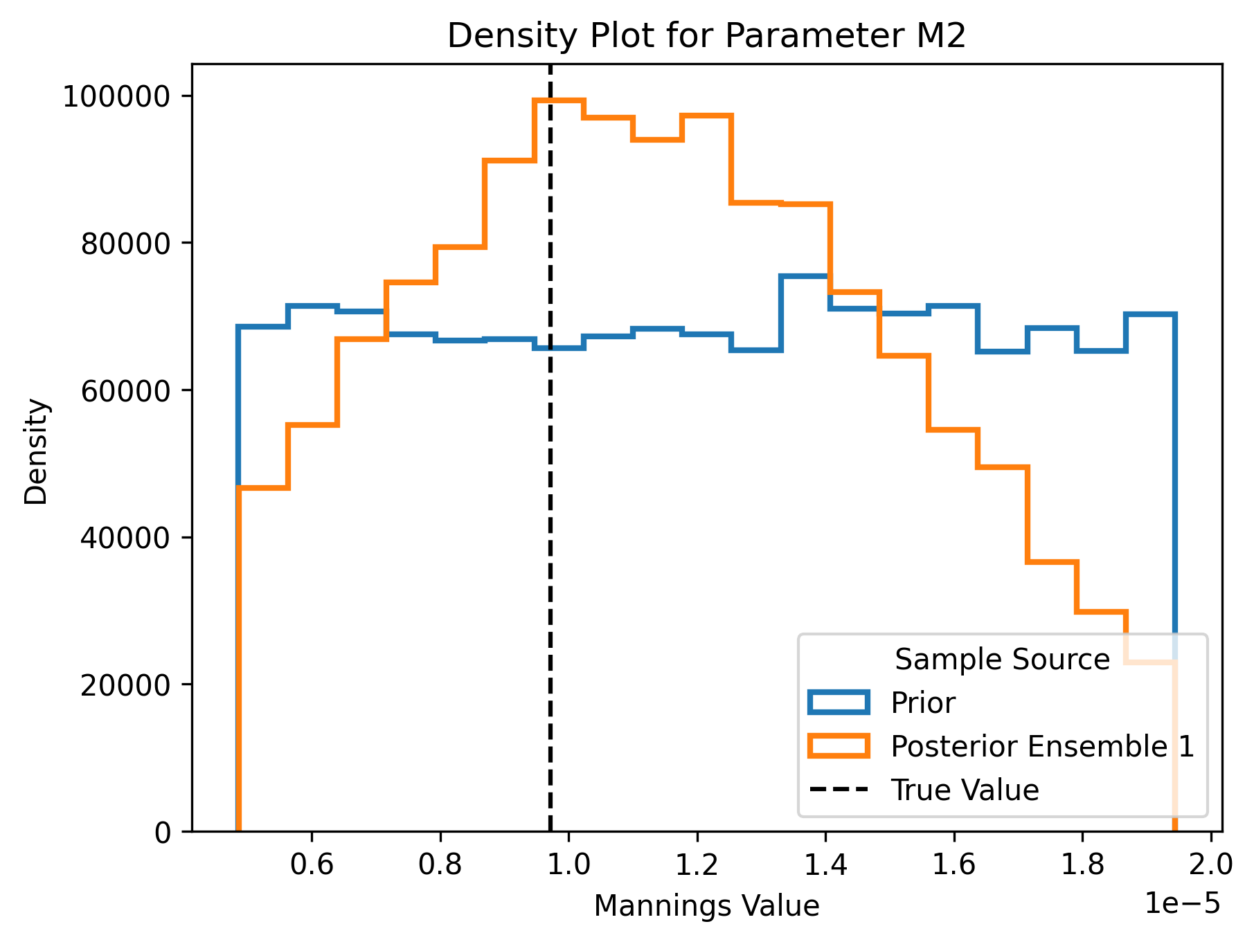
Density plot for M₂
n = 400

Slide 24
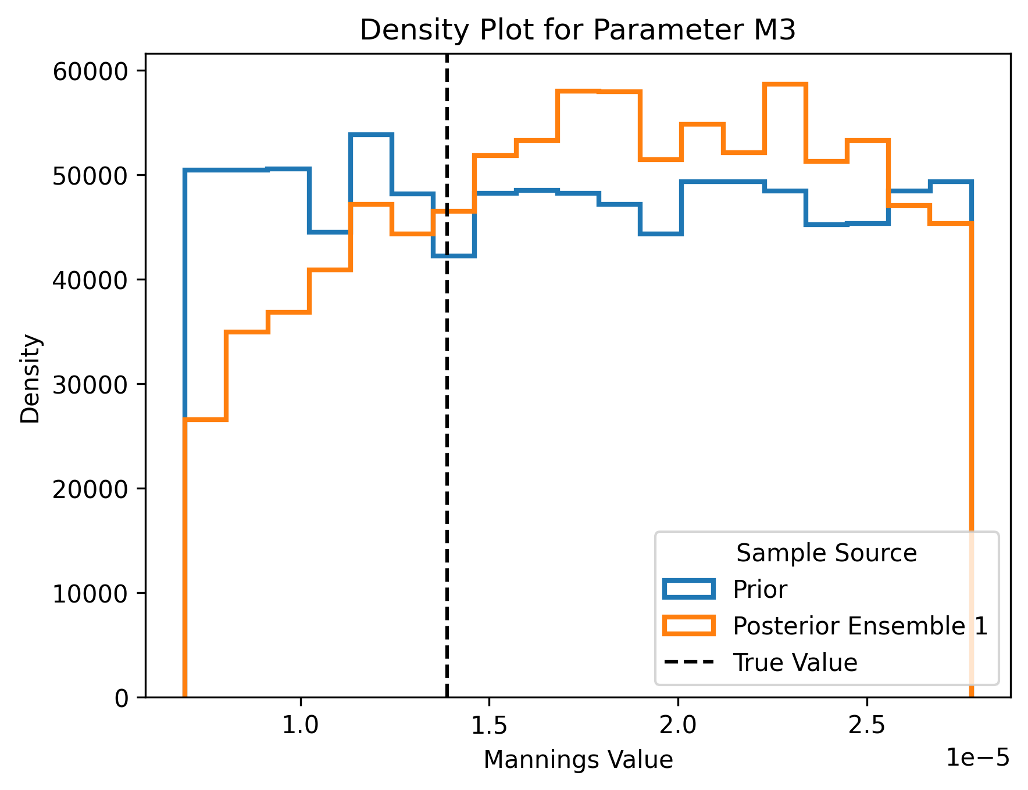
Density plot for M₃
n = 400

Slide 25
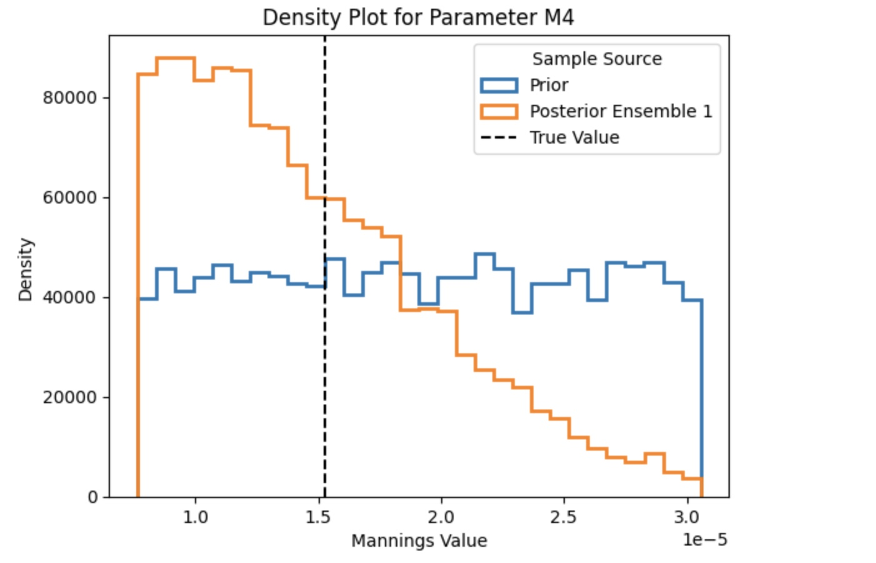
Density plot for M₄
n = 400

Slide 26
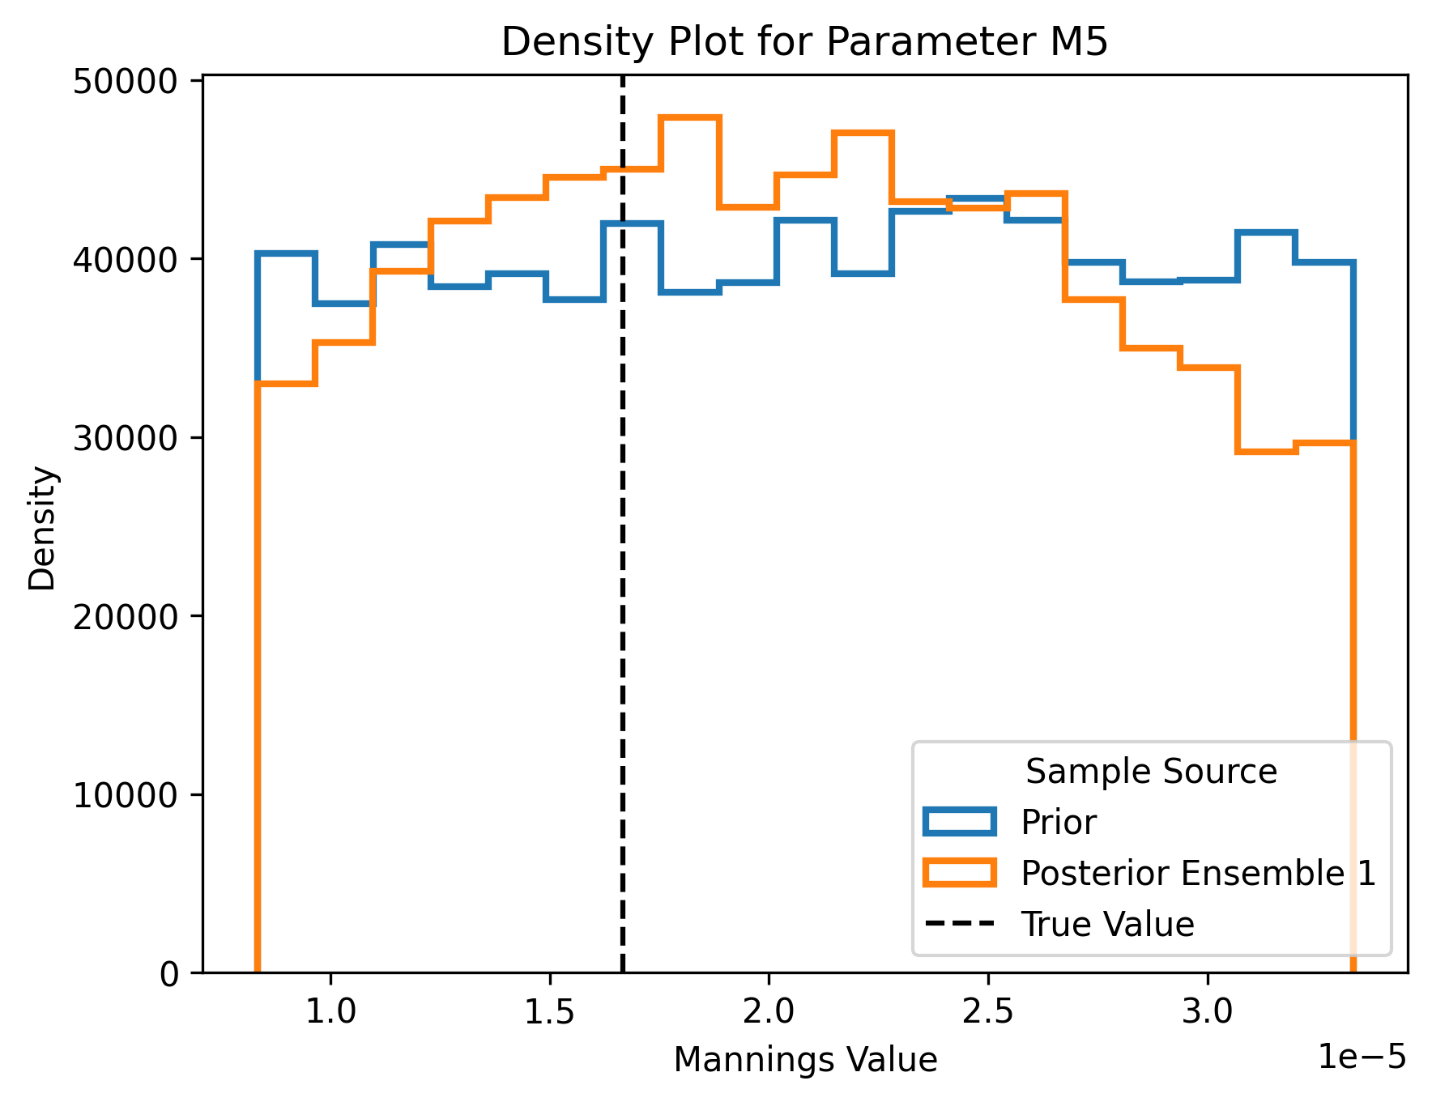
Density plot for M₅
n = 400

Slide 27
Sampling Problems
With 400 simulations and by considering the observed data, 0.5% if the samples are accepted.

Slide 28
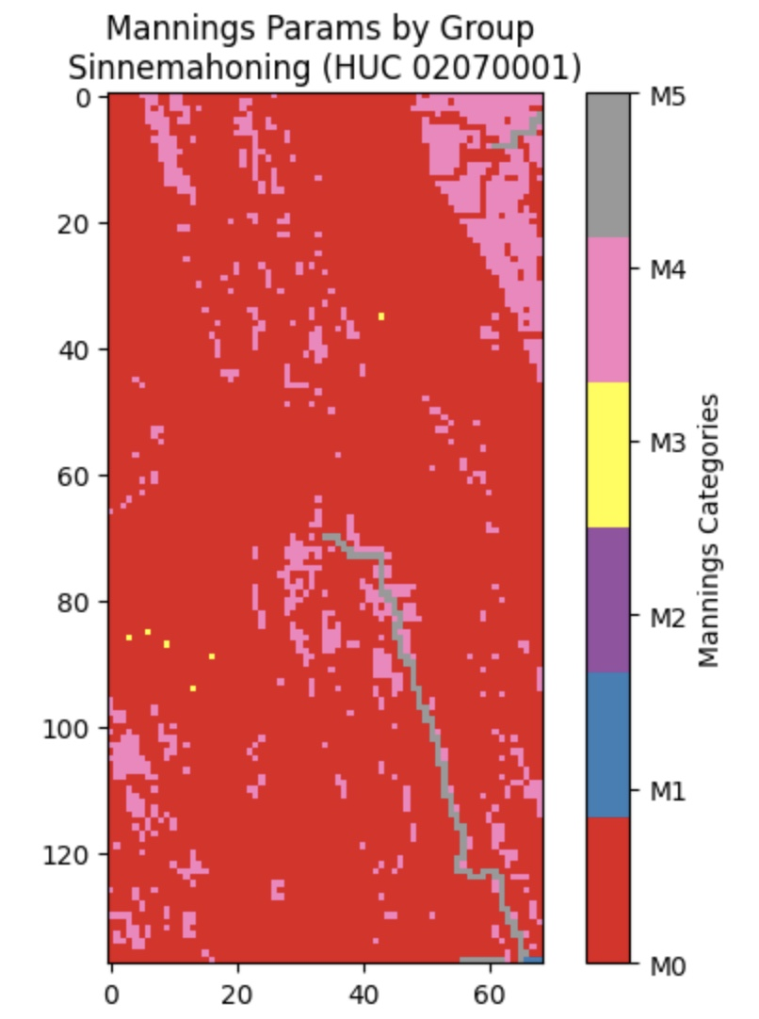
Manning’s spatial distribution

Slide 29
Excel sheet : original Manning’s value for the two different duration

Slide 30
Testing
Increase the number of simulations to learn more the outliers that are in the observed data
Increase noise parameter with increasing the number of simulations
Change the Hyperparameters and increase the learning rate
Sampling the posterior using Markov Chain Monte Carlo as recommended by the library

